Slide 1
Ticketmaster Data Analysis
Project 1
Contributers:
Austin
David
Faisal
Patricia

Slide 2
The Data
url = 'https://app.ticketmaster.com/discovery/v2/events.
Event Name
Classification
Genre (sub-Genre)
Venue
Date
Zip Code
City
State

Slide 3
Limitations
The API would limit us to 1,000 records for a given pull
So we organized our pulls by looping through a list of 10 select cities that were large enough to host a good number of events, but small enough to stay under the 1000 threshold

Slide 4
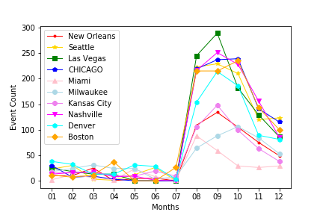
Data only included future events

Slide 5
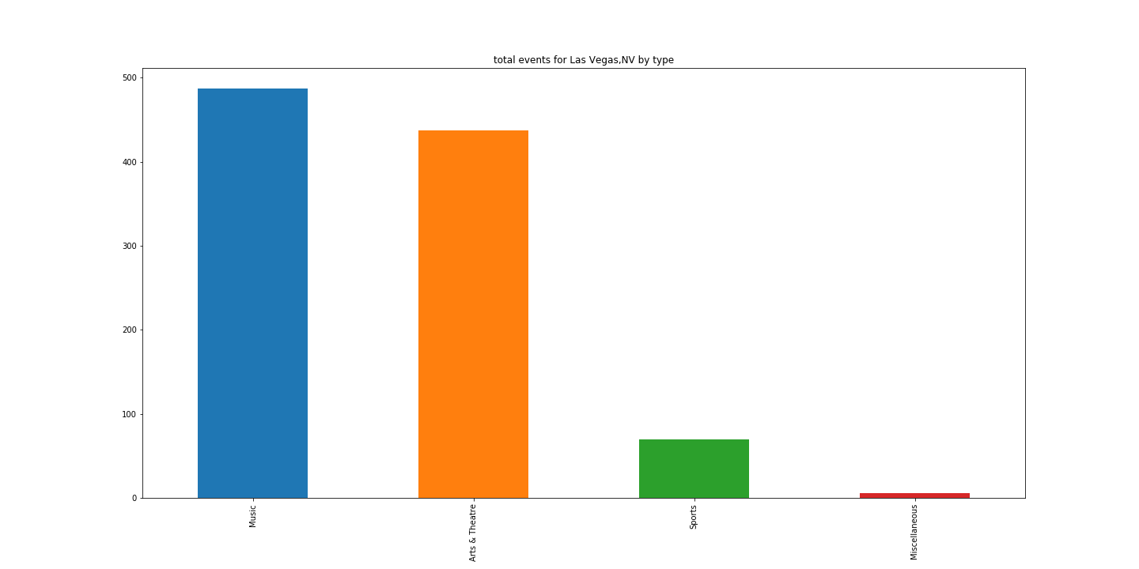
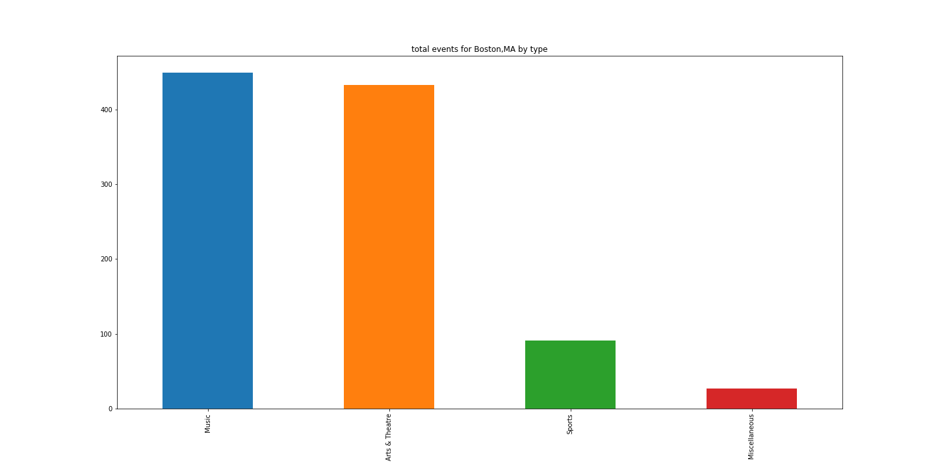
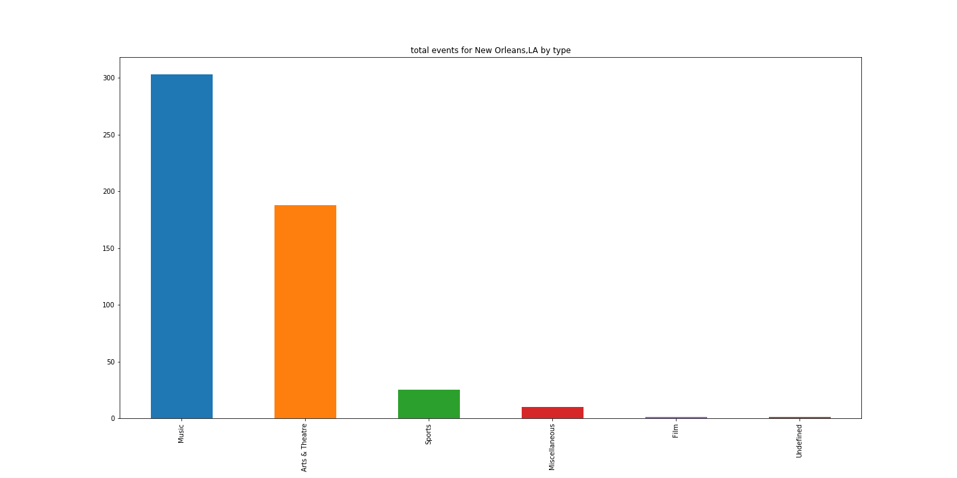
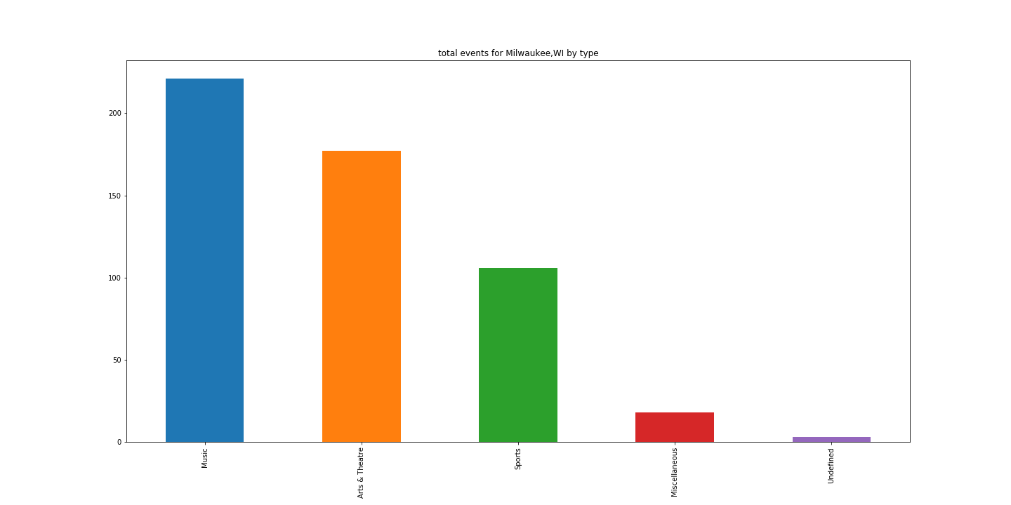
By Classification: Las Vegas, Boston,Milwaukee,New Orleans

Slide 6
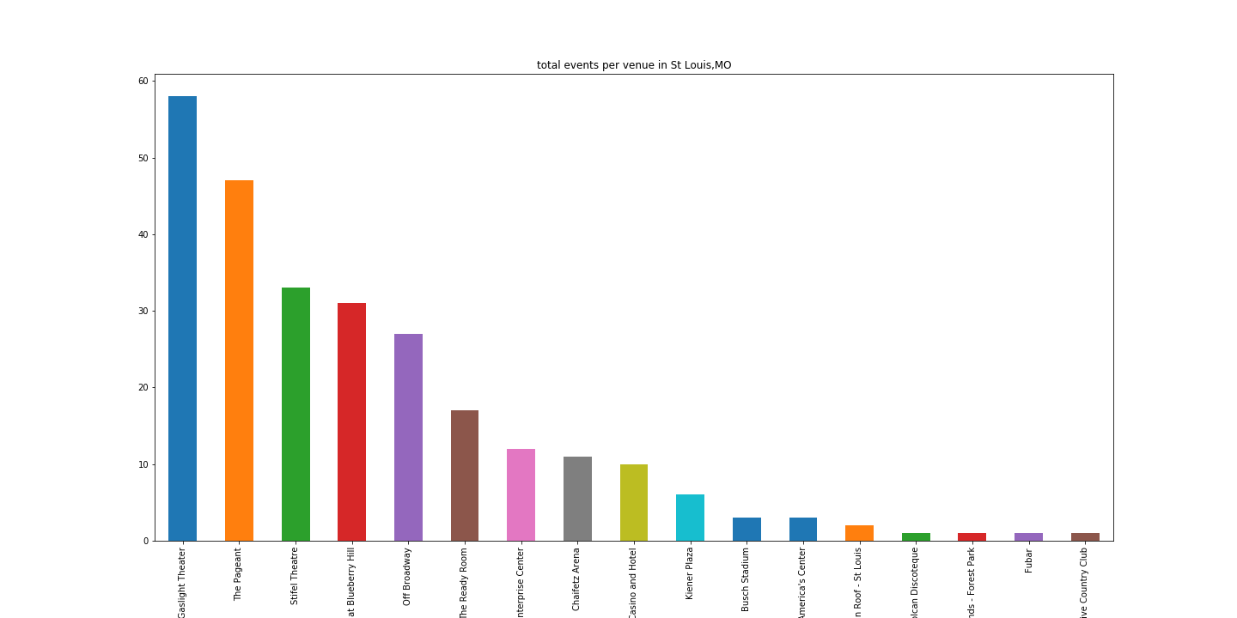
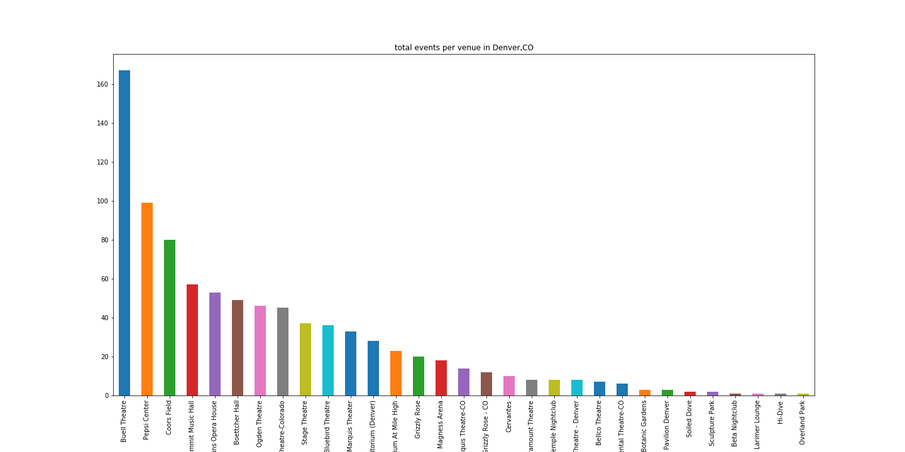
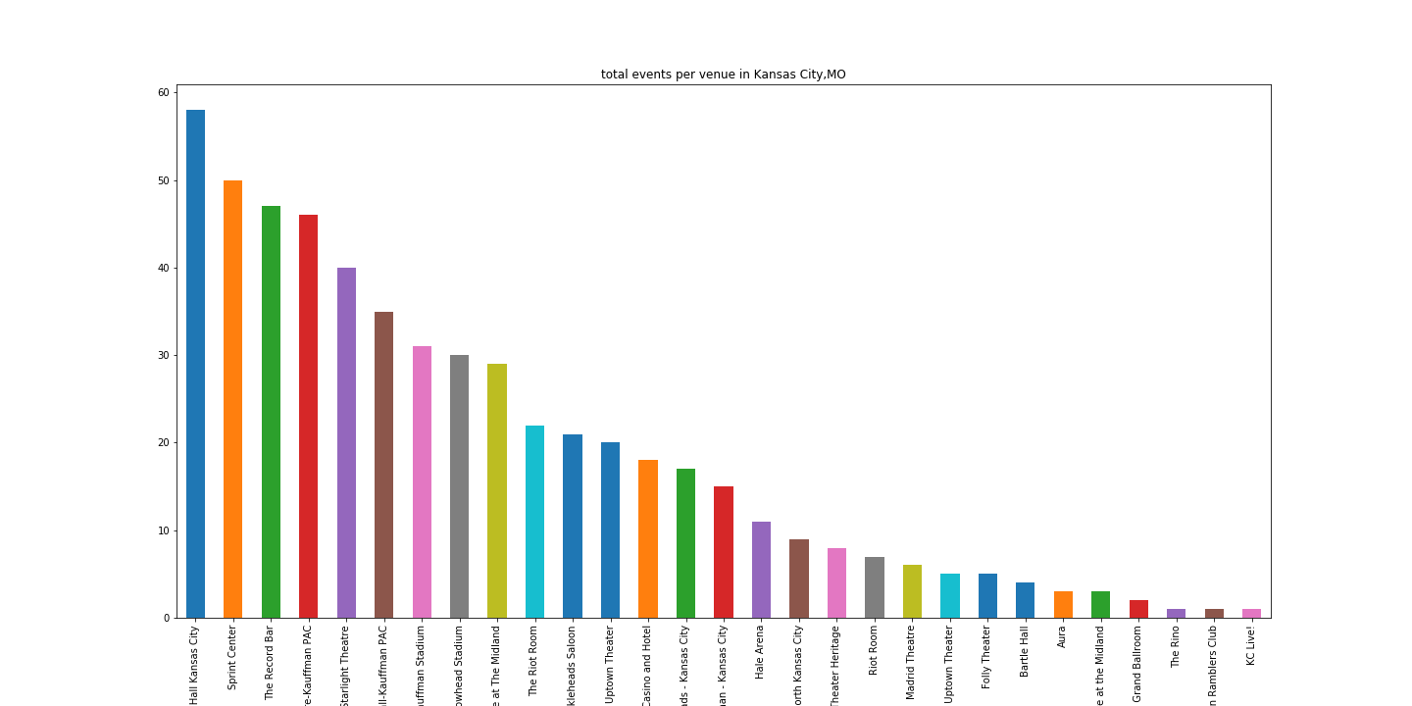
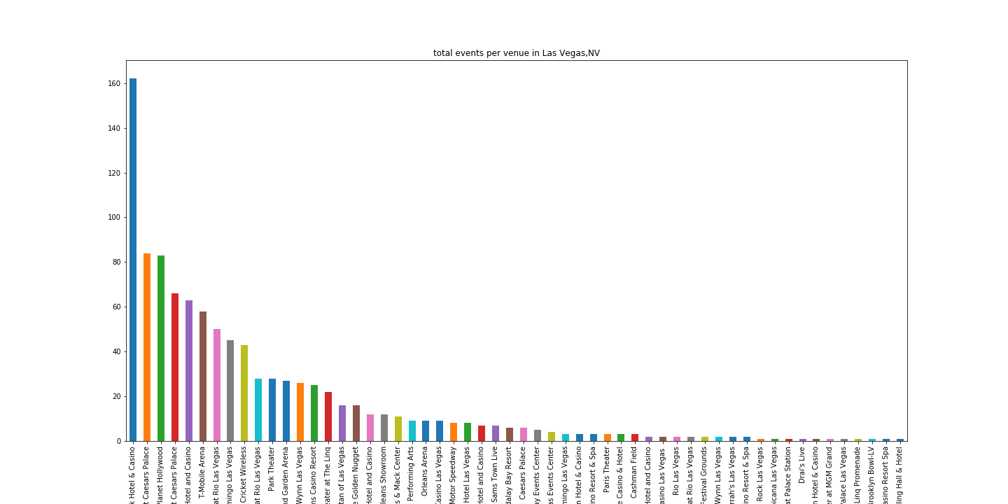
Most Booked Venues by City, St. Louis, Denver, KC, Las Vegas

Slide 7
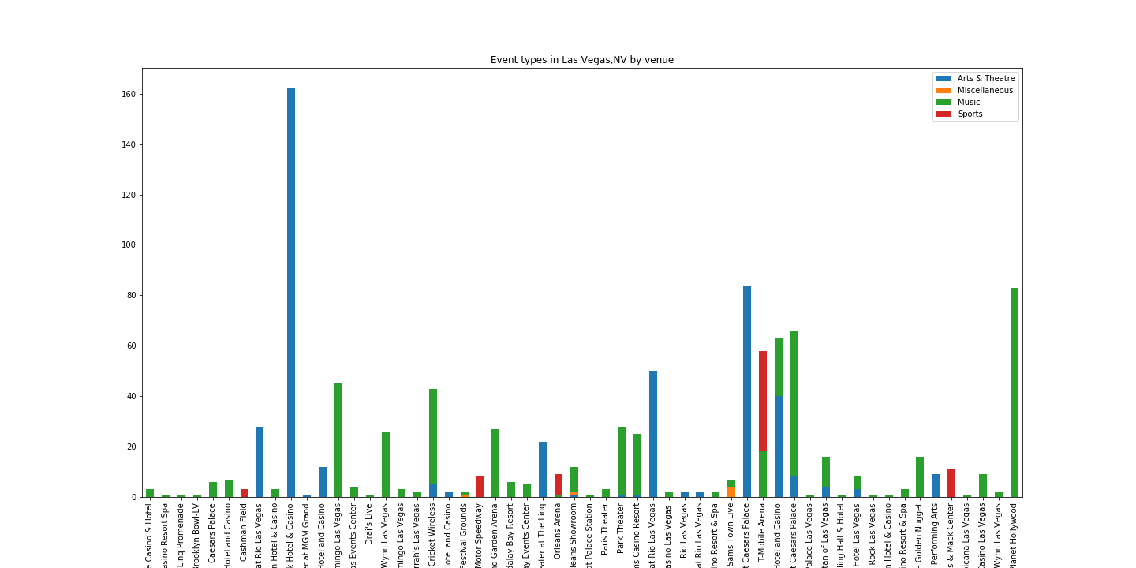
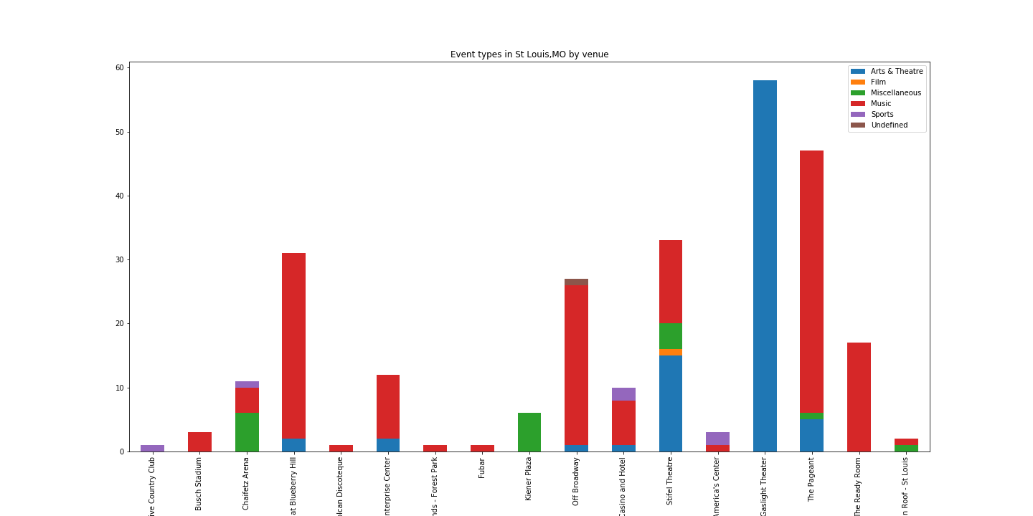
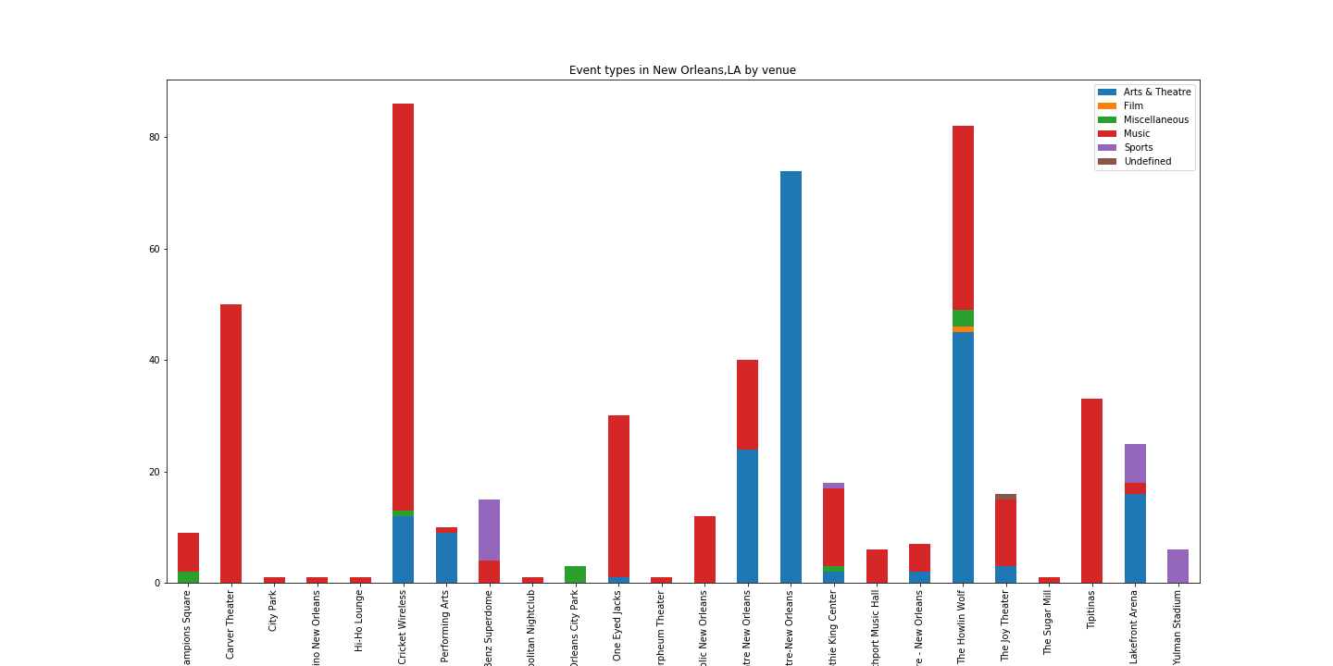
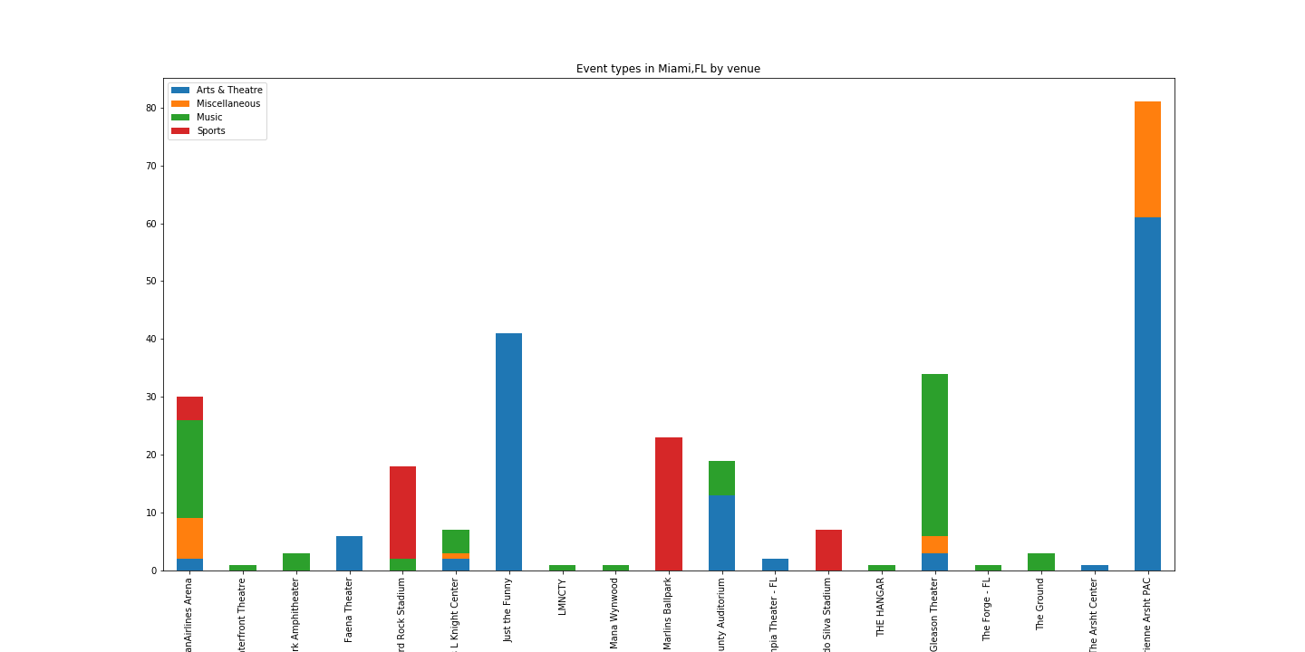
Stacked Bar Graph by Venue – Las Vegas, St. Louis, New Orleans, Miami

Slide 8
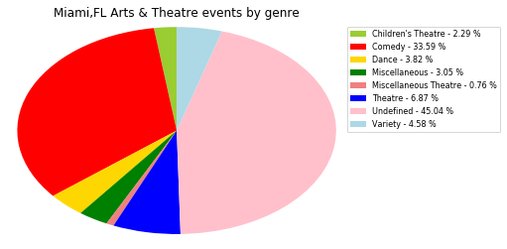
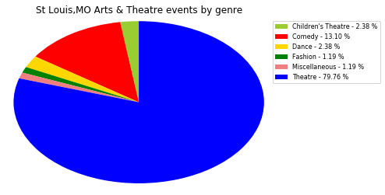
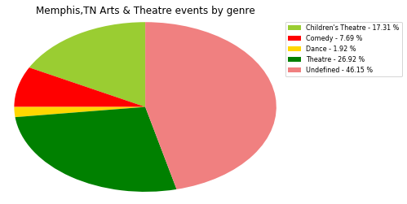
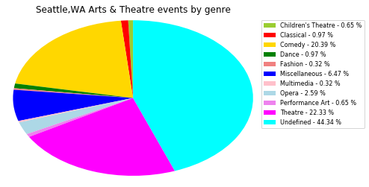
Arts and Theatre by Genre

Slide 9
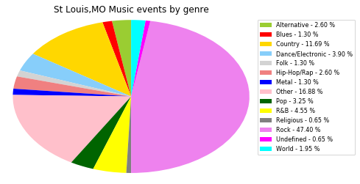
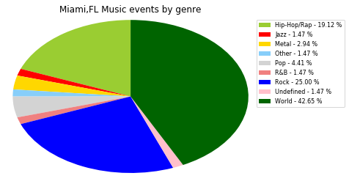
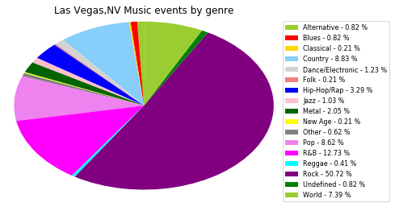
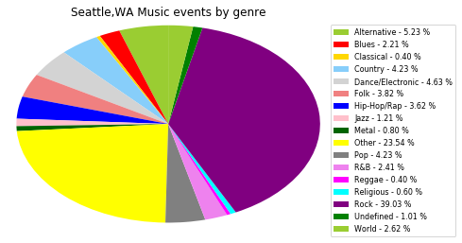
Comparission of

Slide 10
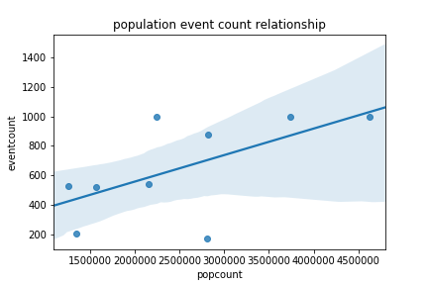
Regressions Chart – Events/Population

Slide 11
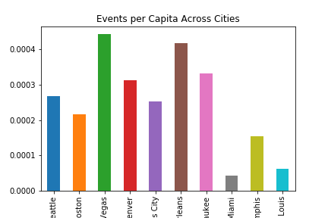
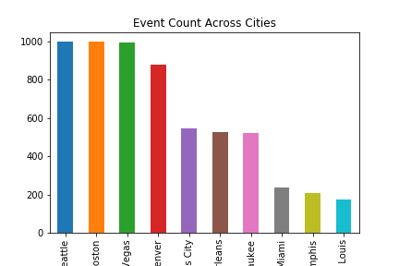
Events / Population Analysis

Slide 12
Events by Income Analysis
I was able to merge Census Data that included Per Capita Income by Zipcode.
The zipcodes were restricted to only those that had an event, but there were enough zipcodes per city to determine a good estimate of the per capita income per city.
groupZip = event_census_df.groupby(['City','Zipcode'])
cityMax = groupZip.City.max()
cityPop = groupZip.Population.max()
cityIncome = (groupZip.PerCapitaIncome.max() * groupZip.Population.max())
cityCnt = groupZip.EventName.count()
-
groupCity = zip_summary_df.groupby('City')
cityMax = groupCity.City.max()
cityPop = groupCity.Population.sum()
cityIncome = ( groupCity.Income.sum() / groupCity.Population.sum())
cityCnt = groupCity.EventCnt.sum()

Slide 13
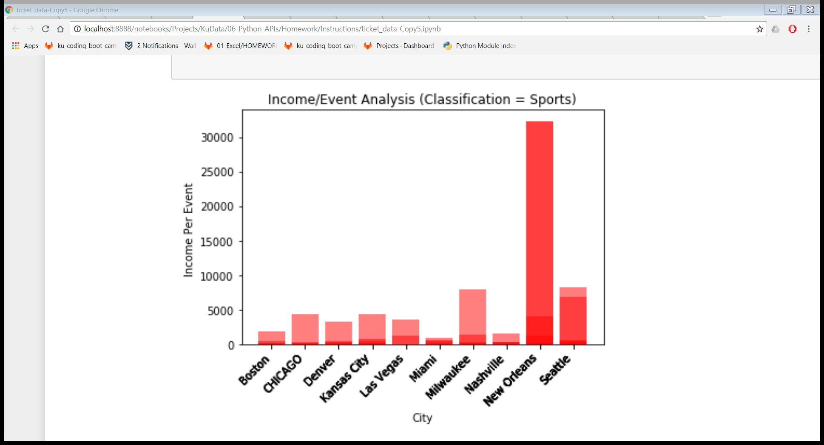
Income/Event – Sports

Slide 14
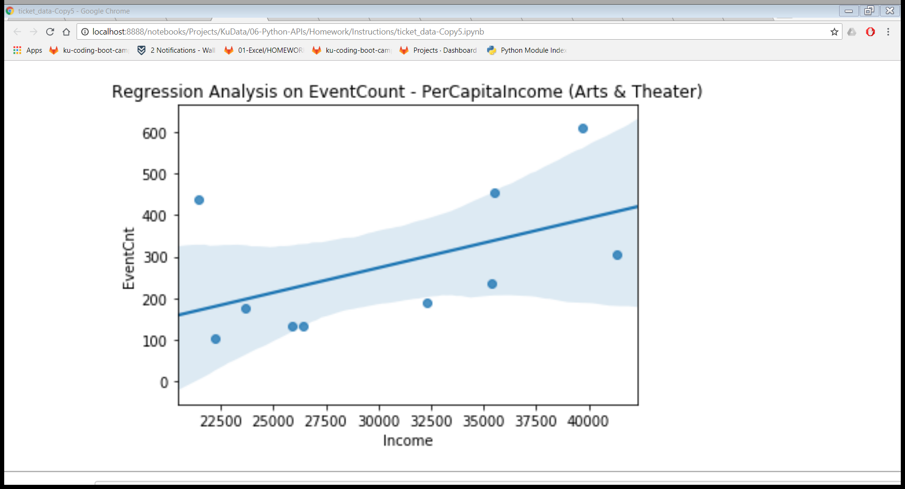
Regression Chart - Arts & Theater

Slide 15
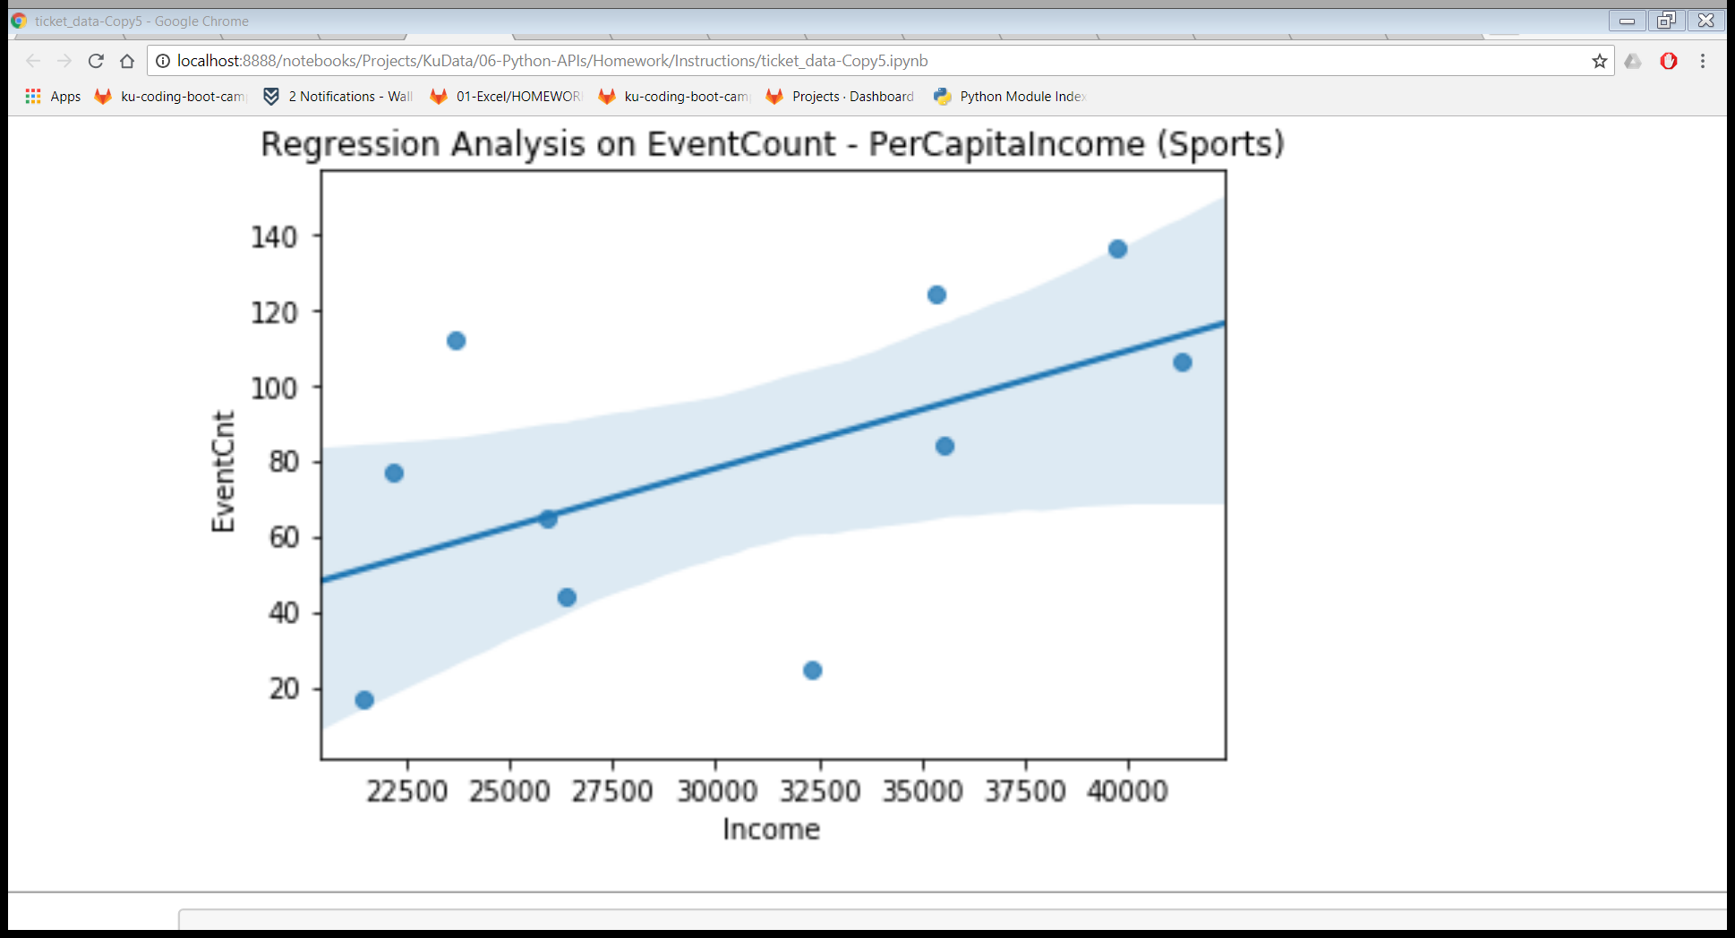
Regression Chart – EventCnt/Income (Sports)

Slide 16
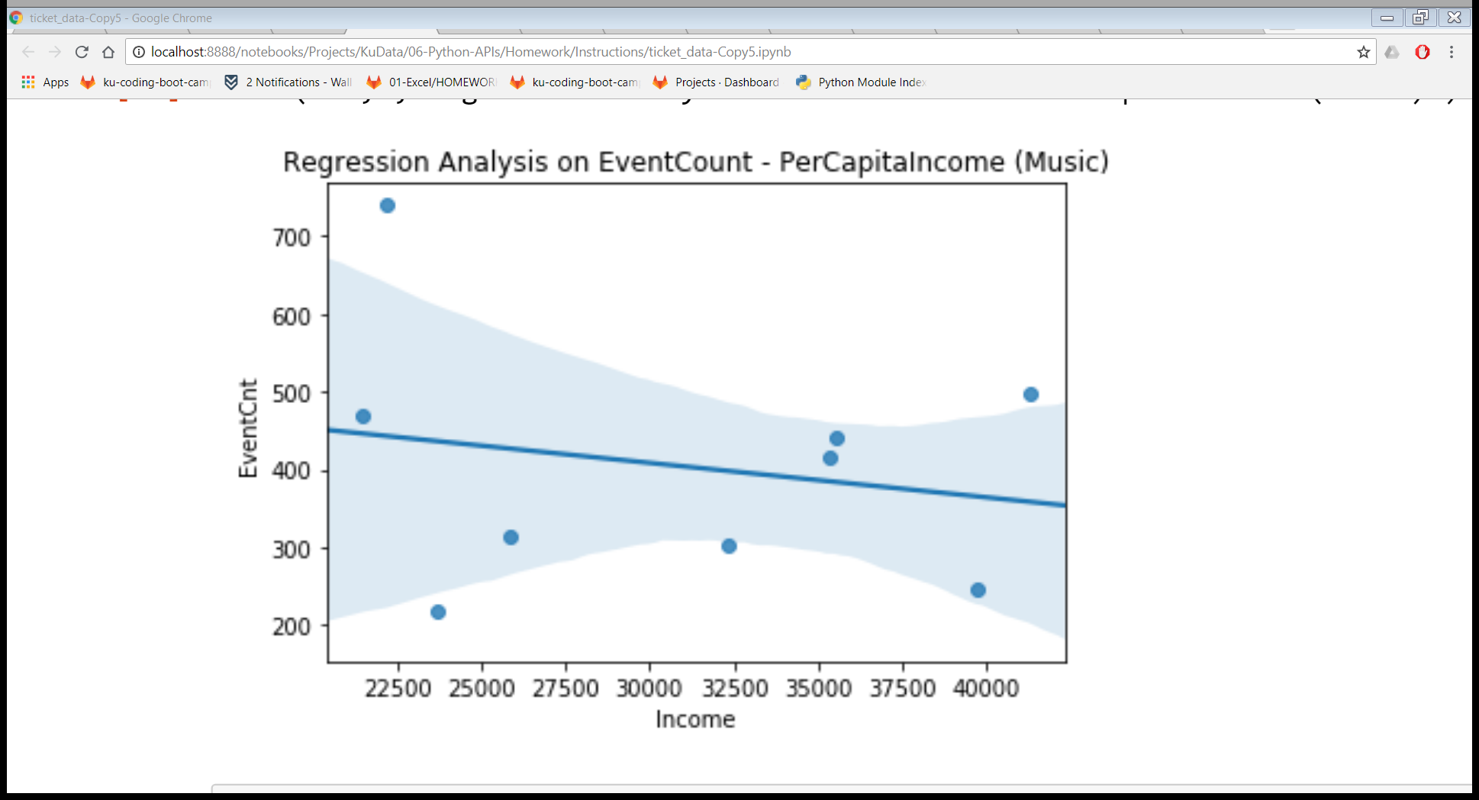
Regression Chart - Music

Slide 17
SCIPY linregress
slope, intercept, r_value, p_value, std_err = stats.linregress(s1,s2)
R-Squared : 0.0073715
0% indicates that the model explains none of the variability of the response data around its mean.
Std_err = 0.03815
Slope = 0.00223
Intercept = 91.4978

Slide 18
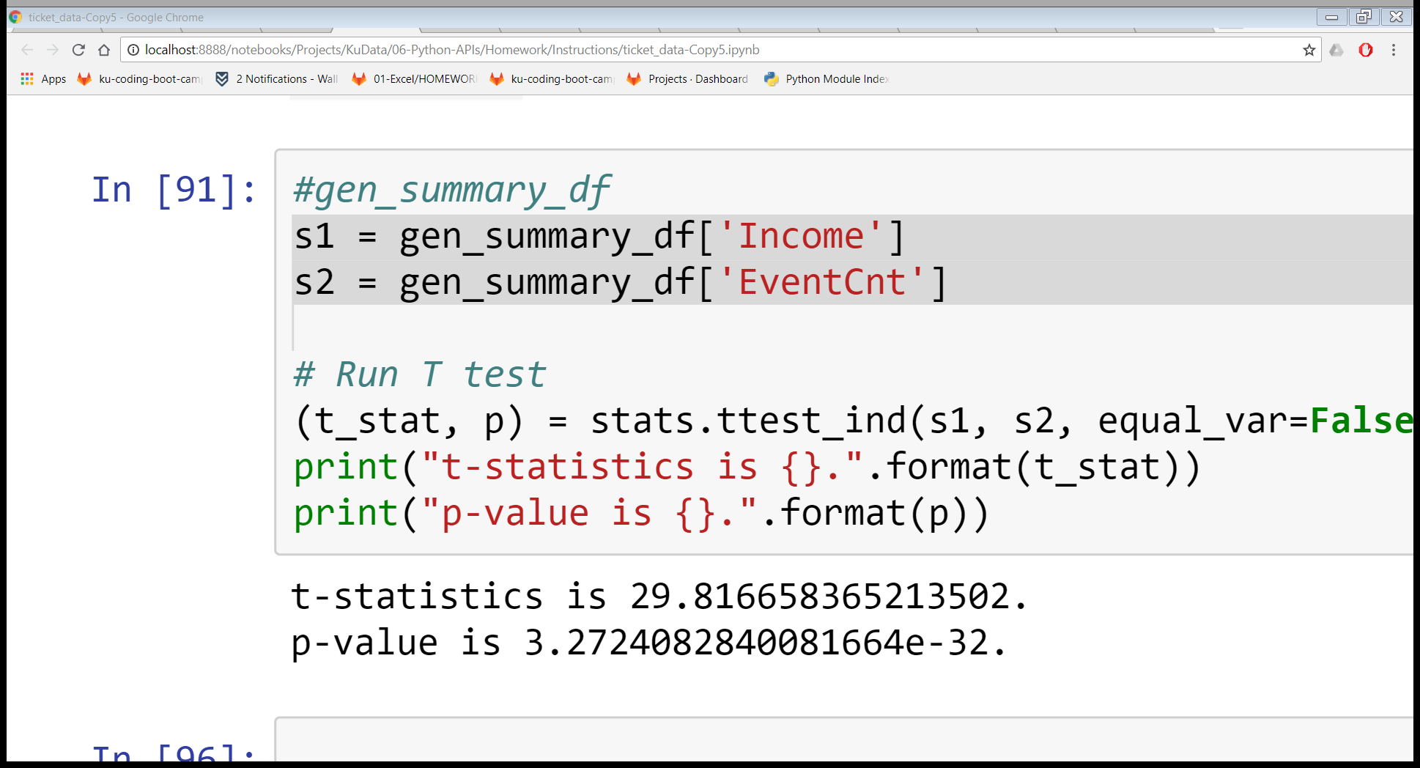
T-Stats and P-Value

Slide 19
Conclusion
The Ticketmaster data is a useful tool in displaying the preferences of a local population, for example, their musical tastes.
The data is insufficient as statistical predictor of future results.
Possible Improvements:
Accumulate the data over a period of time to get a full year
Add more demographic components, such as tourism trends
Add venue capacities to add another dimension
Add average ticket prices per event to combine with venue capcities
Source our data from additional ticket handlers.

